Slide 1

iPhone 17 Pro Max: The Future in Your Hands
Combines cutting-edge technology with premium design for unmatched user experience.
Offers long-term value through Apple’s strong ecosystem and regular software updates.
Represents the latest innovation in smartphone technology, keeping users ahead of trends.

Slide 2
Revolutionary Design
Features a thinner titanium body that is both lightweight and ultra-durable.
Refined edges and minimal bezels create a sleek, futuristic look.
Enhanced ergonomics provide a comfortable and premium in-hand feel.

Slide 3
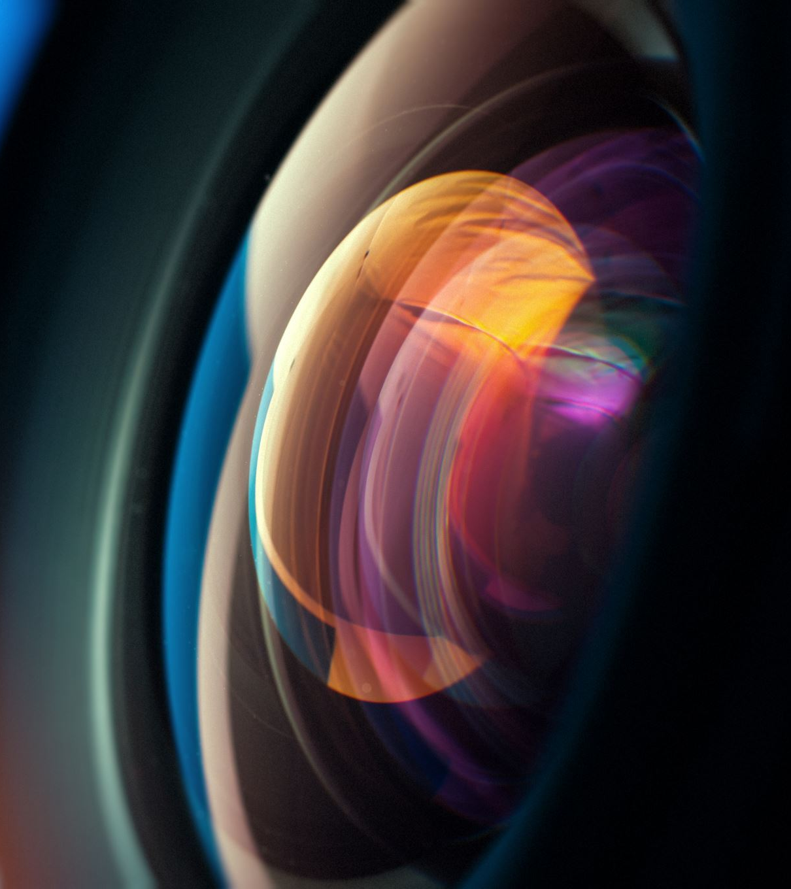
Brilliant Display
Super Retina XDR display offers exceptional color accuracy and brightness.
ProMotion technology delivers ultra-smooth 120Hz scrolling and gaming experiences.
Perfect for streaming, video editing, and professional content creation.

Slide 4
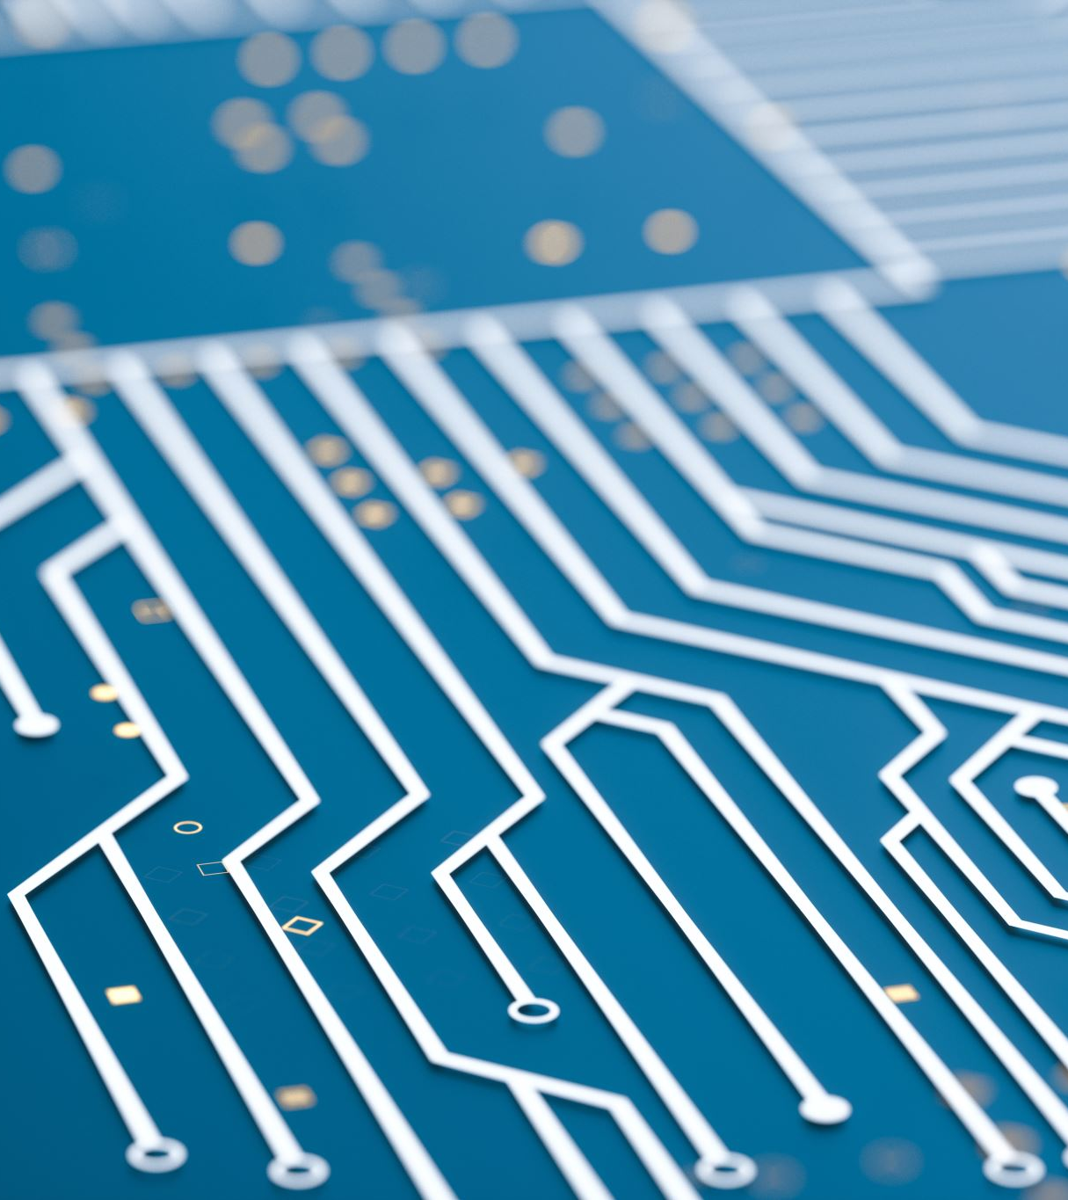
A19 Bionic Power
The most advanced Apple chip yet, delivering lightning-fast performance.
Designed for AI-driven tasks, gaming, and professional-grade workflows.
Provides exceptional efficiency, reducing power consumption.
Future-proofed for years of software updates and demanding apps.

Slide 5
Camera Excellence
Advanced quad-lens system captures studio-quality photos and 8K video.
Improved low-light performance with larger sensors and AI image processing.
New periscope zoom lens delivers incredible detail from any distance.

Slide 6
AI Innovation
Personalized AI assistant adapts to user behavior and preferences.
Smart features enhance daily life—like predictive typing and scene recognition.
AI-driven photography automatically adjusts lighting and color balance.
Boosts efficiency with automated task suggestions and reminders.

Slide 7
Battery & Charging
All-day battery life optimized by intelligent power management.
Supports ultra-fast MagSafe 2.0 charging and new 45W wired charging.
Adaptive charging extends battery lifespan by reducing wear.

Slide 8
Sustainability First
Built with 100% recycled aluminum and rare earthmaterials.
Energy-efficient manufacturing reduces carbon footprint.
Packaging uses biodegradable materials with zero plastic.

Slide 9

Ecosystem Harmony
Seamlessly connects with other Apple devices for a unified experience.
Handoff, AirDrop, and Continuity make productivity effortless across devices.
iCloud ensures data, photos, and messages are always synchronized.

Slide 10

The Future Starts Now
Represents the next era of mobile innovation and digital lifestyle.
Combines performance, sustainability, and intelligence in one device.
Ideal for both professionals and everyday users seeking excellence.
Sets the standard for what future smartphones will strive to be.
Buying now means being part of the cutting edge of technology evolution.

