Slide 1


MP Contracting
Promotional Campaign
Anything you can dream, we can build
Creative Team:
Manuel Pintado
Nicole Cabezas
Cristhian Galiano
Daniella Spurlock
[1]

Slide 2
Key Product Benefits
Durability & Craftsmanship
Custom Design
Local Service & Trust
Longevity & Peace of Mind
Beautiful, personalised spaces
Reliability & Confidence
[2]

Slide 3
Target Market & Launch City
Demographics
• Homeowners aged 28–60+
• Moderate–high income
• Families, new buyers & long-term residents
Launch City – Louisville
• Existing client base & strong reputation
• Aligns with homeowners who value curb appeal
• Leverage momentum to scale locally
Psychographics
• Value reliability, craftsmanship & style
• DIY‑curious but seek professional quality
• Engage on social media for home inspiration
[3]

Slide 4
Advertising Theme
Durability Meets Design
Homeowners don’t have to choose between strength and style.
Beautiful concrete that lasts generations.
[4]

Slide 5

Print Advertisement Concept
Purpose
Inform & persuade Louisville homeowners about MP Contracting’s services. Showcase durability and design through striking imagery.
Buying Motive
Primarily rational – highlight value, quality craftsmanship & long‑term investment; supported by emotional pride in a beautiful home.
Placement
Local home magazines & social platforms frequented by homeowners seeking renovation inspiration.
[5]

Slide 6

Specialty Media: Custom Cardholder
Why a Cardholder?
Practical & durable—keeps MP Contracting top of mind every day.
Distribution Plan
Stage 1: Employees
Stage 2: Family & friends
Stage 3: New customers at contract signing.
Cost: ~$0.70 per unit (bulk order).
“Anything you can dream, we can build”
[6]

Slide 7
Jingle & Press Quote
Jingle Concept
Upbeat and memorable—think Pharrell Williams “Happy” meets home improvement.
Highlights durability, custom design & trust.
Repeats the brand name to reinforce recall.
Press Quote
“Around here, we believe a good foundation isn’t just poured—it’s built with pride, hard work, and a handshake you can trust.”
– Matthew Phillips, Owner
♫
Positive, friendly & modern
[7]

Slide 8
Broadcast Advertising
Chaos at Home
DIY disaster frustrates homeowner – they need expert help.
Rescue Call
Client phones MP Contracting for help – relief is on the way.
Team Arrives
Crew assesses & schedules work – clear next steps provided.
Happy Reveal
Transformed space & satisfied client – durable beauty achieved.
Radio
WAKY-FM (Classic Hits) – top choice for adults 25+ in Louisville.
Airing during morning (5–9 AM) & evening (3–6 PM) commutes maximises reach.
Television & Social
30–60 second testimonial spot broadcast on WLKY/WDRB & targeted social ads (Facebook, Instagram, TikTok). Prioritise 80% budget on social and 20% on local TV to reach both digital and traditional audiences.
[8]

Slide 9
Social & Digital Funnel
Awareness
People discover MP Contracting & learn our value
Lead Capture
We capture contact info to continue the conversation
Nurture
Share testimonials & tips to build trust and excitement
Booking
Clients easily schedule a site visit & quote
Referral
Delighted clients spread the word through reviews & referrals
[9]

Slide 10
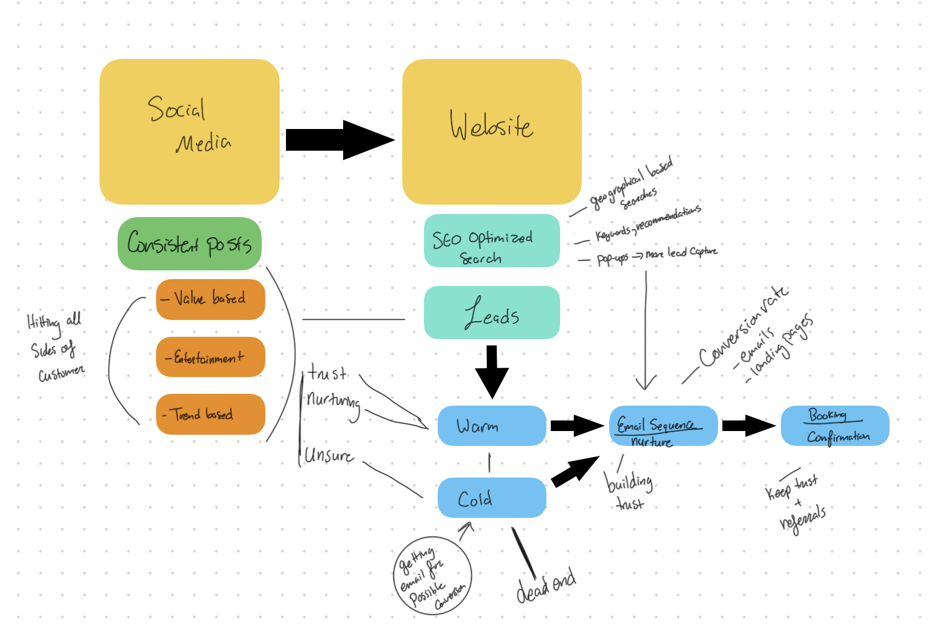
Digital Marketing Setup

Slide 11
Weekly Content Schedule
Day | Theme | Content | Posting Time
Mon | Motivation Monday | Before & After + inspirational copy | 6–8 PM
Tue | Tip Tuesday | How‑to clip or maintenance hack | 6–8 PM
Wed | Worksite Wednesday | B‑roll & relatable moment | 12–2 PM
Thu | Testimonial Thursday | Customer review or success story | 6–8 PM
Fri | Feature Friday | Highlight unique service | 6–8 PM
Sat | Showcase Saturday | Full transformation reel | 9–11 AM
Sun | Community Day | Faith, family or community post | 6–8 PM
Posting Guidance
• 3–5 posts weekly across Instagram, Facebook & TikTok
• 3-10 Stories daily for behind‑the‑scenes engagement
• Batch shoot b‑roll & clips at job sites
[10]

Slide 12
Email & Lead Nurturing
Confirmation
“Thanks & next steps”
Personal response
Gather project details
Social proof & value
Share testimonials
Quote follow‑up
Answer questions
Project confirmation
Provide prep tips
Reminder
24–48hr before start
Thank you & Review
Invite feedback & referrals
[11]

Slide 13
Conclusion & Next Steps
Highlight durability, design & trust to attract homeowners
Focus on Louisville: build on existing reputation & referrals
Integrate print, radio, TV & digital for full‑funnel impact
Automate nurture & referral loops to sustain growth
Questions?
Thank you for your time and trust.
[12]

